Slide 1
(Dec 21, 2016)
Exploiting Expertise Rules for Statistical
Data-Driven Modeling
Cheng Jianlin
Notes:
利用专业(专家)规则来进行统计数据驱动建模
对于复杂的工业过程而言，数据的获取不仅费时而且费力，所以通常数据量是很少的。所以如何利用有限的训练样本去建立复杂的模型显得很重要。
最近这几年，大家用的比较多就是非线性模型，对于非线性模型来说，虽然说它们能对于小数据进行有效的建模，取得不错的效果，但是它们缺少透明度，可理解性比较差。
这篇文章的思路就是，在原来非线性模型的基础上加入专家规则，可以有效地提高数据驱动建模能力。 最后这篇文章用了三个实验来证明这个它们提出的模型是有效的。

Slide 2

Why add Rules?
· they are human readable and interpretable
· they can easily be edited since decision makers can sift through
all these rules to edit and update according to their own needs

Slide 3
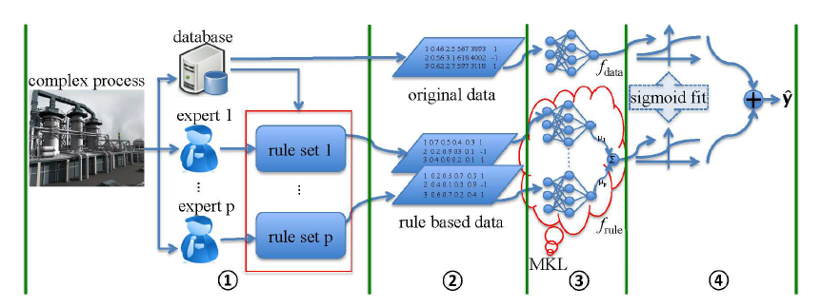
Notes:
加入专家规则后的非线性模型框架。

Slide 4
Outline
I. Rule based Data Expression
II. Rule based Data Fusion by l2 Multiple Kernel Learning
III. Ensemble Data and Rule based Model by Sigmoid Fitting
IV. Results

Slide 5
I. Rule based Data Expression
CART is used as a preprocessing step to extract if· · · then· · · rules.
Notes:
我们知道决策树对于那些特征之间没有太多关系的系统而言，分类效果是比较好的，
但是，对于大多数复杂工业过程来说，(属性)特征之间是有很强关系的，所以准确率会降低很多，因此这里把CART用来提取if…then规则。

Slide 6
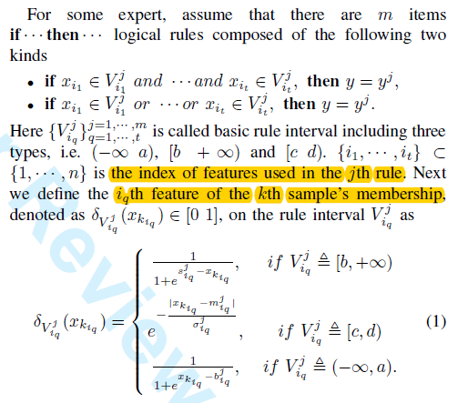
I. Rule based Data Expression

Slide 7
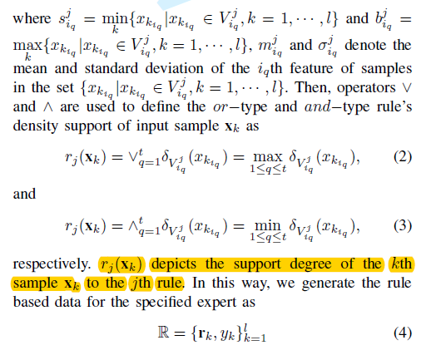
I. Rule based Data Expression

Slide 8
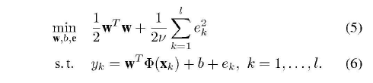

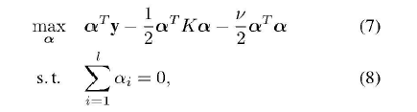
II. . Rule based Data Fusion by l2 Multiple Learning

Slide 9


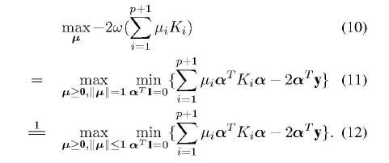
II. . Rule based Data Fusion by l2 Multiple Learning

Slide 10
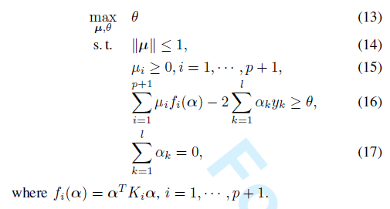
II. . Rule based Data Fusion by l2 Multiple Learning

Slide 11


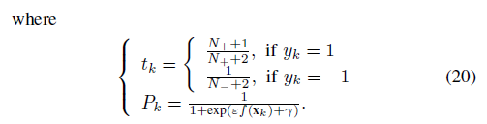
III. Ensemble Data and Rule based Model by Sigmoid Fitting
Notes:
优化一个交叉熵误差函数

Slide 12

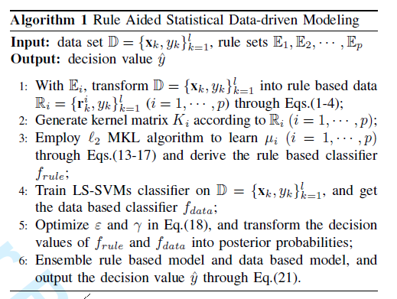
III. Ensemble Data and Rule based Model by Sigmoid Fitting
Notes:
n个点的话，就需要考虑n的平方个点之间的关系，梯度计算就会比较复杂。

Slide 13
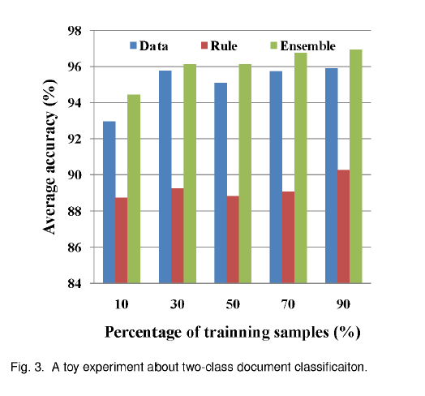
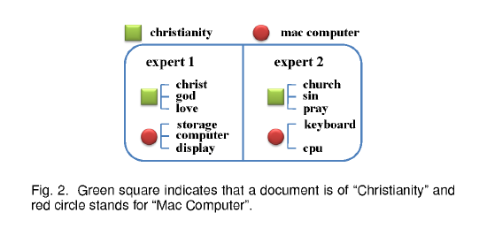
IV. Results
· A Toy Experiment
Notes:
新闻组的数据集

Slide 14
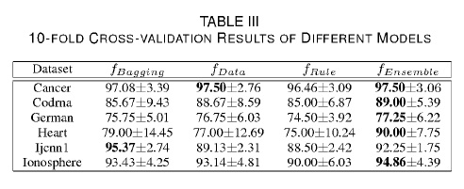
IV. Results
·Evaluating the Performance on Benchmark Datasets
Notes:
评估在基准数据集上的效果

Slide 15
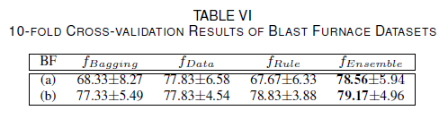
IV. Results
·Tendency Prediction of Thermal State of Blast Furnace
Notes:
高炉热状态的趋势预测
硅含量的趋势预测

Slide 16
Bibliography
[1] Exploiting Expertise Rules for Statistical Data-Driven Modeling

Slide 17









Thanks！

